Slide 1
DOCTORAL COMMITTEE MEETING – II 31, Dec.’22 PROGRESS REPORT
Research Scholar | : | RICHA THAKUR (19PE102)
Research Supervisor | : | DR. ADITYA NIGAM
Area of Research | : | DEEP LEARNING
Sub-topic | : | BLACK-BOX ADVERSARIAL ATTACK ON PRE-TRAINED BIOMETRIC-BASED AUTHENTICATION SYSTEMS

Slide 2
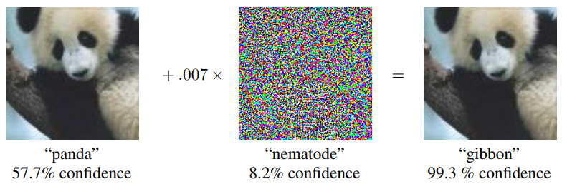
INTRODUCTION
ADVERSARIAL ATTACKS ON CLASSIFICATION MODELS
Adversarial attacks are those malicious attacks on the data which may seem okay to the human eye but causes misclassification in a machine-learning pipeline. These attacks are often made in the form of specially designed “noise,” which causes misclassification.
An Adversarial Attack is a technique to find a perturbation that changes the prediction of a machine learning model.
Fig. 1: An Adversarial Example

Slide 3
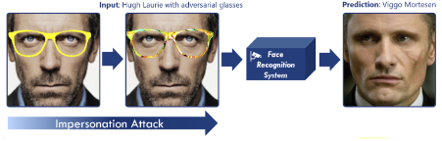
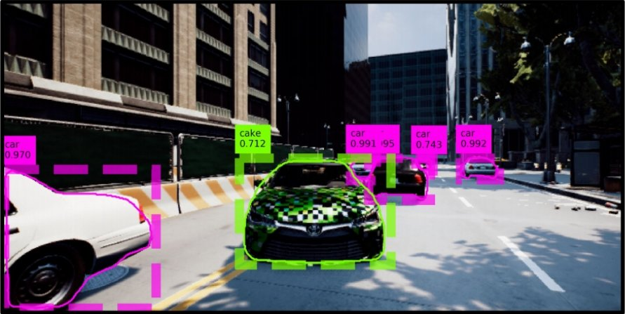
MOTIVATION
BLACK-BOX ADVERSARIAL ATTACK ON CLASSIFICATION MODELS
Adversarial attacks are crafted to find the vulnerabilities in the ML models which later can be used to improve the robustness of a neural network or ML model.
Example Applications:
Fooling an Automated Vehicle System.
Hacking a Face Recognition System (FRS) in
public camera surveillance (CCTV).
Fig. 2: Fooling an Automated Vehicle Classification System
Fig. 3: Hacking a Face Recognition System

Slide 4
PROPOSAL and OBJECTIVES
Proposed:
Video-based black-box adversarial attacks on pre-trained biometric systems.
Problem 1: Black-box adversarial attack in video-based analysis.
Objectives:
To see the effect of intensity-based noise on an Image dataset. (Partial Complete)
To perform an adversarial black-box attack on SOTA architectures using Transferability. (Completed)
To perform an adversarial black-box attack on Videos. (presently working on)

Slide 5
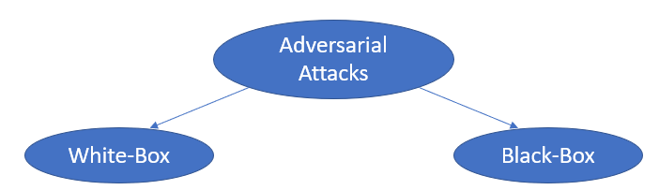
ADVERSARIAL ATTACKS ON CLASSIFICATION MODELS
Table 1: Classification of Adversarial Attacks based on model access
 | White-Box Attack | Black-Box Attack (more practical)
Adversary Knowledge | Detailed knowledge includes: Network architecture (No. of layers, types of layers) Input, output Training Data Weights, and hyperparameters | No knowledge, except: Querying the model on input, and observing the labels.

Slide 6
LITERATURE SURVEY
Intriguing properties of Neural Networks [1]
First mention of adversarial examples but could not justify the cause properly.
Discovered blind spots in neural networks intuitively because of the complex representations learned by a deep neural network
Explaining and Harnessing Adversarial Examples [2]
Gives the cause of adversarial examples.
Devised a method (FGSM: Fast Gradient Sign Method) to generate them.
Fig. 4: A Fast Gradient Adversarial Example Generation applied to GoogLeNet on ImageNet [2]
[1] Szegedy, C., Zaremba W., Sutskever I., Bruna J., Erhan D., Goodfellow I., and Fergus R. “Intriguing properties of neural networks”, CVPR, 2014, URL: https://doi.org/10.48550/arXiv.1312.6199.
[2] Goodfellow I. J., Shlens J., and Szegedy C. “Explaining and Harnessing Adversarial Examples”, ICLR, 2015, URL: https://doi.org/10.48550/arXiv.1412.6572.

Slide 7
LITERATURE SURVEY
Table 3: White-Box Techniques
Technique | Attacked on | Introduced in
FGSM (Fast Gradient Sign Method) [2] | Attack on gradients | 2015
BIM (Basic Iterative Method) [3] | Attack on gradients | 2016
PGD (Projected Gradient Descent) [4] | Attack on gradients | 2017
CW (Carlini and Wagner) [4] | Attack on optimization algorithm | 2017
AdvGAN (Adversarial GANs) [4] | Attack on input images | 2018
[2] Goodfellow I. J., Shlens J., and Szegedy C. “Explaining and Harnessing Adversarial Examples”, ICLR, 2015, URL: https://doi.org/10.48550/arXiv.1412.6572.
[3] Kurakin A., Goodfellow I., and Bengio S. “Adversarial Examples in the Physical World”. ICLR 2017, URL: https://doi.org/10.48550/arXiv.1607.02533.
[4] Wang, C., Wang, J., and Lin, Q. “Adversarial Attacks and Defenses in Deep Learning: A Survey”. Intelligent Computing Theories and Application, ICIC 2021, Springer, URL: https://doi.org/10.1007/978-3-030-84522-3_37.

Slide 8
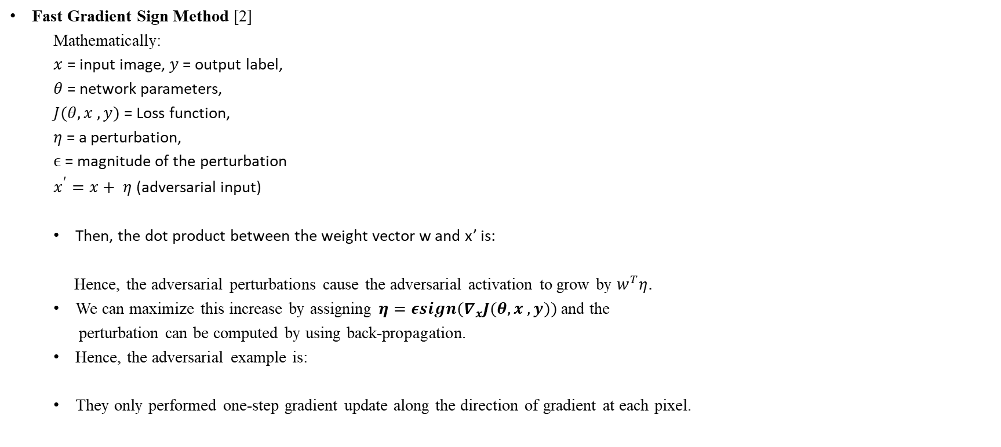
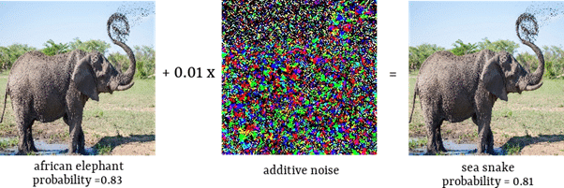
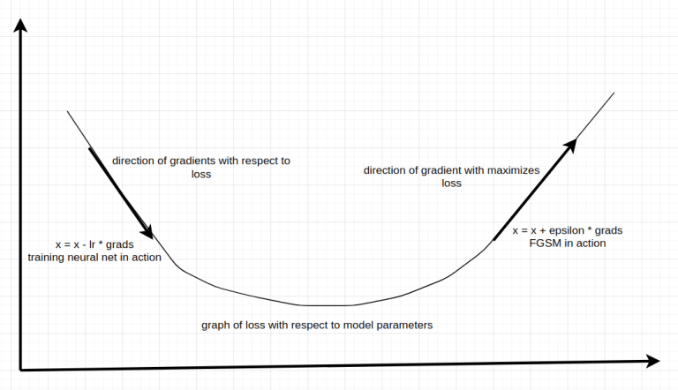


LITERATURE SURVEY
Fig. 5: A Fast Gradient Adversarial Example Generation applied to GoogLeNet on ImageNet [2]
Fig. 6: FGSM in action
[2] Goodfellow I. J., Shlens J., and Szegedy C. “Explaining and Harnessing Adversarial Examples”, ICLR, 2015, URL: https://doi.org/10.48550/arXiv.1412.6572.

Slide 9
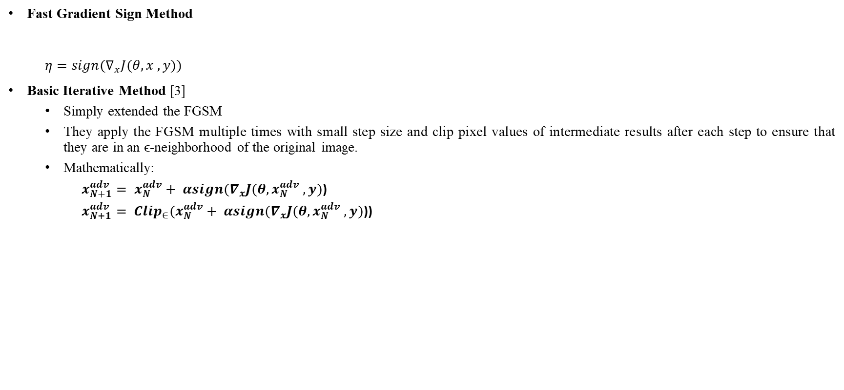

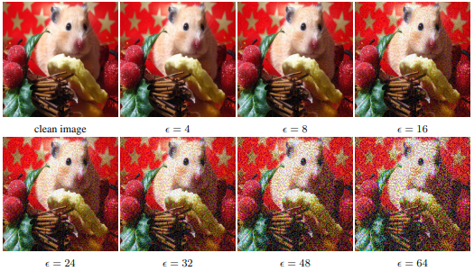
LITERATURE SURVEY
Fig. 7: An Adversarial Example Generation using Basic Iterative Method
[3] Kurakin A., Goodfellow I., and Bengio S. “Adversarial Examples in the Physical World”. ICLR 2017, URL: https://doi.org/10.48550/arXiv.1607.02533.

Slide 10
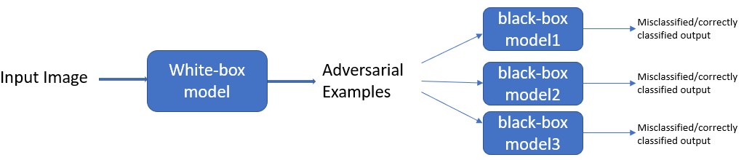
LITERATURE SURVEY
Black-Box Technique:
Transferability [5]
The authors showed that a black box attack can be carried out on a target model by transferring the adversarial examples of a locally trained network. However, such a technique still requires knowledge of the dataset and training procedure of the target model.
In the context of adversarial attacks, transferability means that the adversarial examples generated from one model are also very likely to be misclassified by another model. One possible explanation of inherent attack transferability for DNNs lies in the findings that DNNs commonly have overwhelming generalization power and local linearity for feature extraction.
Fig. 8: Transferability in black box adversarial attacks
[5] Papernot N., McDaniel P., Goodfellow I., Jha S., Celik Z. B., and Swami A. “Practical Black-box attacks against Machine Learning”. Proceedings of the 2017 ACM on Asia Conference on Computer and Communications Security, URL: https://doi.org/10.1145/3052973.3053009.

Slide 11
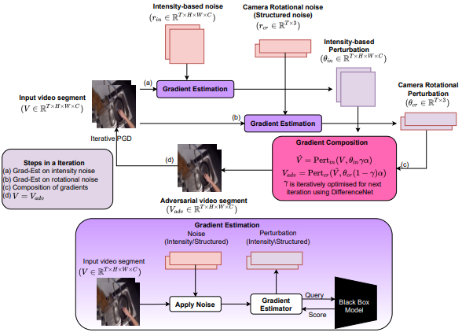
LITERATURE SURVEY
Black-Box Techniques applied to videos: Merry Go Round: Rotate a Frame and Fool a DNN [6]
Fig. 9: Overview of the framework for black-box video attack
[6] Thapar D., Nigam A., and Arora C., “Merry Go Round: Rotate a Frame and Fool a DNN”, CVPR, Mar 2022.

Slide 12
Fig. 9: Overview of the framework for black-box video attack

Slide 13
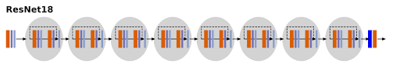
Objective 1: To see the effect of intensity-based noise on an Image dataset.
Dataset: Microsoft Cats vs Dogs images dataset. 1000 training images for each class. 500 testing images for each class.
Creating our Model: Residual Network with 18 layers (ResNet18).
Image recognition models have two parts: the convolutional part and the classifier part. Keep the pre-trained convolutional
part but put in our own classifier. Fine-tuning the ConvNet: Load a pretrained model and reset the final fully connected layer.
Add a linear layer with 512 input features and 2 output features.
Define the cross-entropy loss function for the final layer.
Optimize the parameters of the final layer, using Stochastic Gradient Descent.
iii. Training the Model: Trained the model to classify cats and dogs using ResNet18 for ten epochs.
Fig. 10: A ResNet18 Architecture

Slide 14
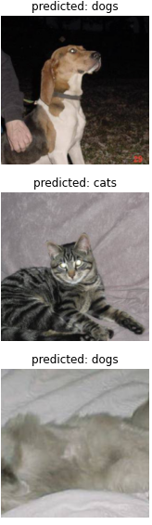
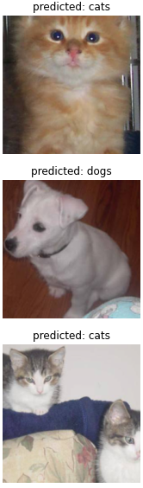
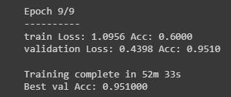
Objective 1: To see the effect of intensity-based noise on an Image dataset.
iv. Results after Training:
Fig. 11: Accuracy of the model
Fig. 12: Predictions generated for test dataset images

Slide 15

Objective 1: To see the effect of intensity-based noise on an Image dataset.
Generate and add intensity-based noise to a randomly picked image:
In a black-box setting where we don’t know the exact gradients. We are estimating the gradients using the finite difference
method.
Finite difference method estimates the direction of the gradient g of some function l at a point in the direction of a vector r as:

Slide 16
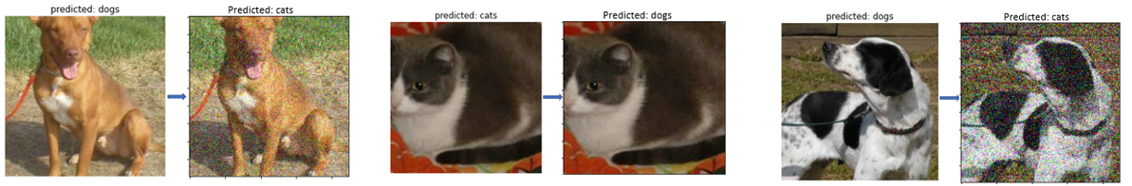
Objective 1: To see the effect of intensity-based noise on an Image dataset.
Results after misclassification:
Evaluation Matric: Number of queries.
Perceptibility: Visually seen.
Fig. 13: Misclassified with no. of queries 211
Fig. 14: Misclassified with no. of queries 114
Fig. 15: Misclassified with no. of queries 332

Slide 17
Objective 2: To perform an adversarial black-box attack on SOTA architectures using Transferability
WHITE-BOX ADVERSARIAL ATTACK:
We will take a subset of the Microsoft cat-vs-dog dataset of 1000 images (500 dogs and 500 cats) to create adversarial examples using FGSM technique.
Resnet50 is our victim model for this attack.
Using the FGSM method we will obtain pixels of adversarial image.
We will feed these adversarial images as input to our victim model and predict their labels.
Now we will compare the predicted adversarial labels to original labels and calculate the accuracy of our attack.
Table 1: Results of white-box attack
Total No. of Images | Successful misclassification | Unsuccessful misclassification
1000 | 990 | 10
Accuracy | 99.0%

Slide 18
Objective 2: To perform an adversarial black-box attack on SOTA architectures using Transferability
BLACK-BOX ADVERSARIAL ATTACK:
We created 3 different models: Mobilenet, VGG19, and Resnet152V2 and used them as our victim models for black box adversarial attacks.
We preprocessed both, the original subset of images used in white-box adversarial attacks and the generated adversarial examples. We fed them as input to our victim models.
For each victim model, we get 2 predictions (one for original image, other for adversarial image). Then we decoded the predictions and compared the labels for each victim model.
We calculated the misclassification accuracy of each model to check which model performs better against our adversarial examples.
Table 2: Results of black-box attack
Total No. of Images | Successful misclassification (ResNet152) | Successful misclassification (MobileNet) | Successful misclassification (VGGNet)
1000 | 999 | 999 | 16
Accuracy | 99.9% | 99.9% | 1.6%

Slide 19
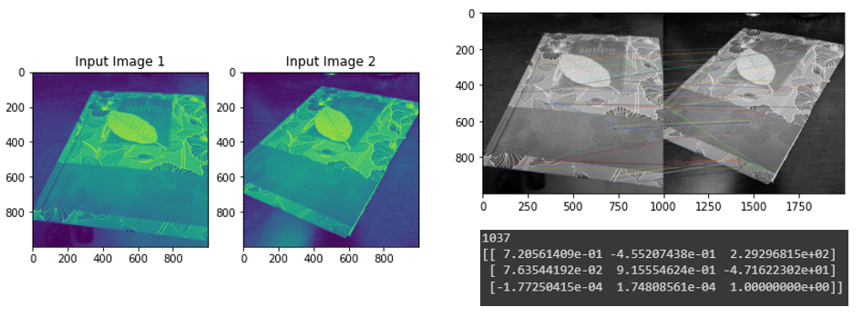
Objective 3: To perform an adversarial black-box attack on Videos using SOTA GPT-2 architecture (presently working on)
Now we are dealing with videos and hence the noise/perturbation generated should be structured because videos have a relation in the temporal dimension.
Homographies: It is a mapping between two planar projections of an image. It is represented by a 3x3 transformation matrix in a homogenous coordinates space.
Fig. 16: Homographies between two images

Slide 20
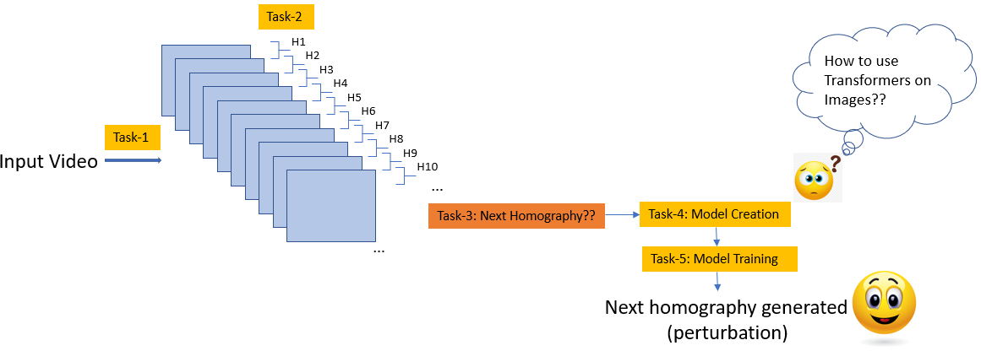
Objective 3: To perform an adversarial black-box attack on Videos using SOTA GPT-2 architecture (presently working on)
Methodology used:
Fig. 17: Overview of the methodology being used to generate a structured noise

Slide 21
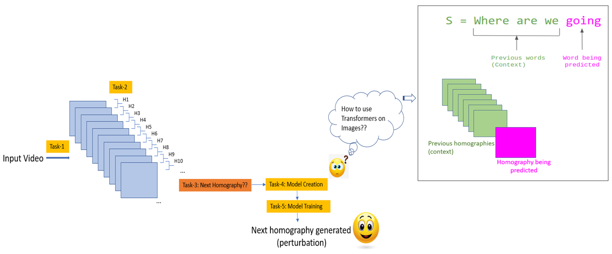
Objective 3: To perform an adversarial black-box attack on Videos using SOTA GPT-2 architecture (presently working on)
Fig. 18: Overview of the methodology being used to generate a structured noise using SOTA GPT-2 architecture

Slide 22
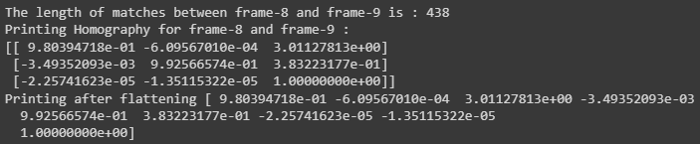
Objective 3: To perform an adversarial black-box attack on Videos using SOTA GPT-2 architecture (presently working on)
Task 1 and 2: We are able to convert any input video to frames and generate homographies for every adjacent pair of frames.
Results:
Fig. 19: Homography matrix generated between a pair of frames

Slide 23
Objective 3: To perform an adversarial black-box attack on Videos using SOTA GPT-2 architecture (presently working on)
Fig. 18: Overview of the methodology being used to generate a structured noise using SOTA GPT-2 architecture

Slide 24
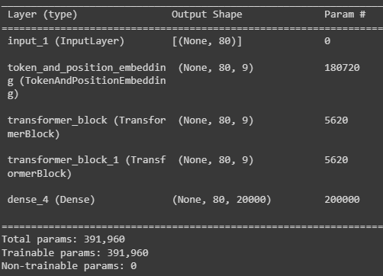
Objective 3: To perform an adversarial black-box attack on Videos using SOTA GPT-2 architecture (presently working on)
Task 4: We successfully created a miniature version of GPT-2 using only two Transformers decoder layers.
Results:
Fig. 20: Model Summary

Slide 25
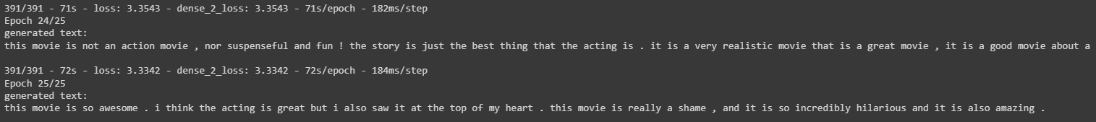
Objective 3: To perform an adversarial black-box attack on Videos using SOTA GPT-2 architecture (presently working on)
Task 4: We successfully trained this miniature version of GPT-2 on IMDB dataset of movie reviews. Downloaded the IMDB dataset and combine training and validation sets for a text generation task.
Results:
Fig. 21: A trained GPT-2 generating meaningful sentences for a Language Modeling task

Slide 26
Objective 3: To perform an adversarial black-box attack on Videos using SOTA GPT-2 architecture (presently working on)
Fig. 18: Overview of the methodology being used to generate a structured noise using SOTA GPT-2 architecture

Slide 27
Thank you…

